Slide 1
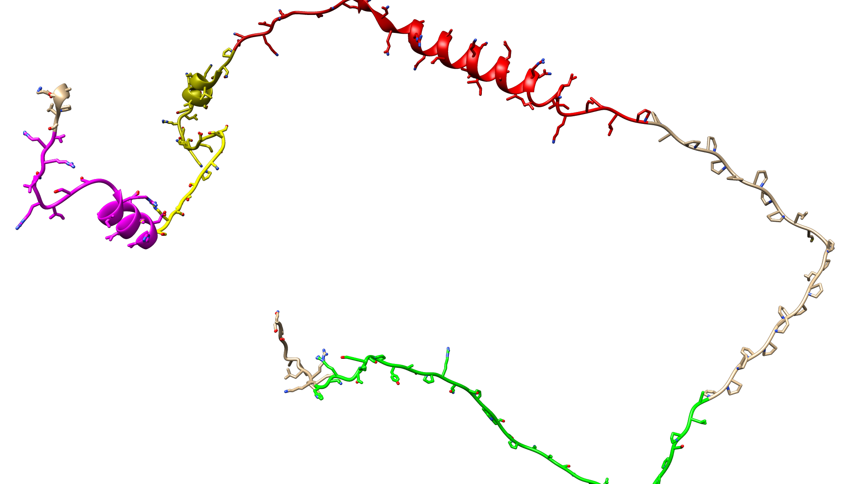
STAT 523 Project
Group 10: Mason Summers and Jonas Talley
Data obtained from Figure 4 of:
Little, M., Risi, C. M., Larrinaga, T. M., Summers, M. D., Nguyen, T., Smith, G. E., Jr, Atherton, J., Gregorio, C. C., Kostyukova, A. S., & Galkin, V. E. (2025). Interaction of cardiac leiomodin with the native cardiac thin filament. PLoS biology, 23(1), e3003027. https://doi.org/10.1371/journal.pbio.3003027

Slide 2
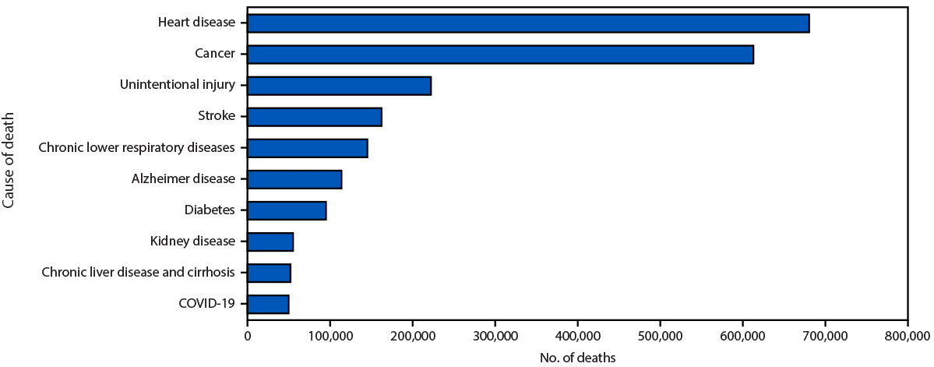
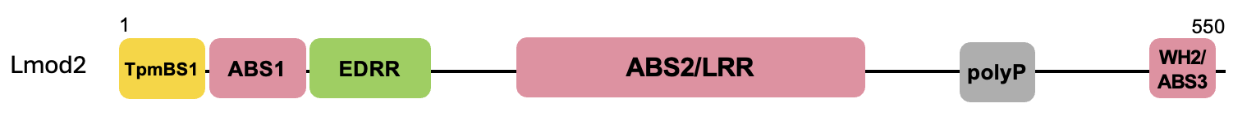
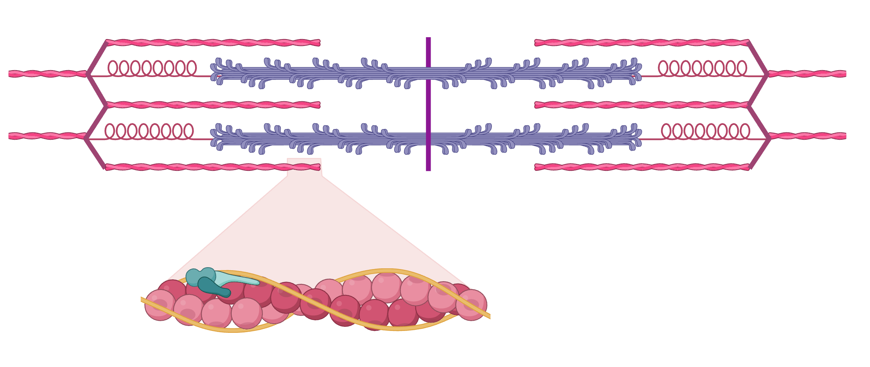
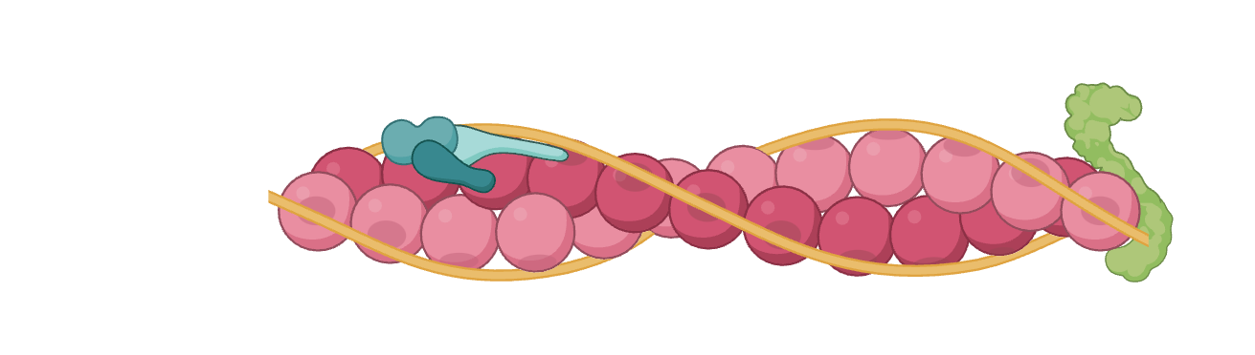
Motivation/Background
According to the CDC, heart disease is the leading cause of death for men, women, and people of most ethnic groups in the US
Prevention and treatment require an understanding of the underlying mechanisms that affect heart function
The C-terminal portion of Lmod2 has regions with an unknown purpose that, when removed, prevent proper heart function
There are disease-causing mutations in humans, such as W398* (truncation at residue 398), which is accompanied by severe cardiomyopathy resulting in death
Studying these regions will help with efforts to fully understand how the heart works and to develop better treatments for heart disease
It’s hypothesized that these unknown regions bind the sides of TFs
C-terminal portion
Unknown Regions
Sarcomere (smallest unit of muscle fiber that causes contraction)
Pointed end
Thin Filament (TF)
https://www.cdc.gov/heart-disease/data-research/facts-stats/index.html#:~:text=Coronary%20heart%20disease%20is%20the,3
Lmod

Slide 3
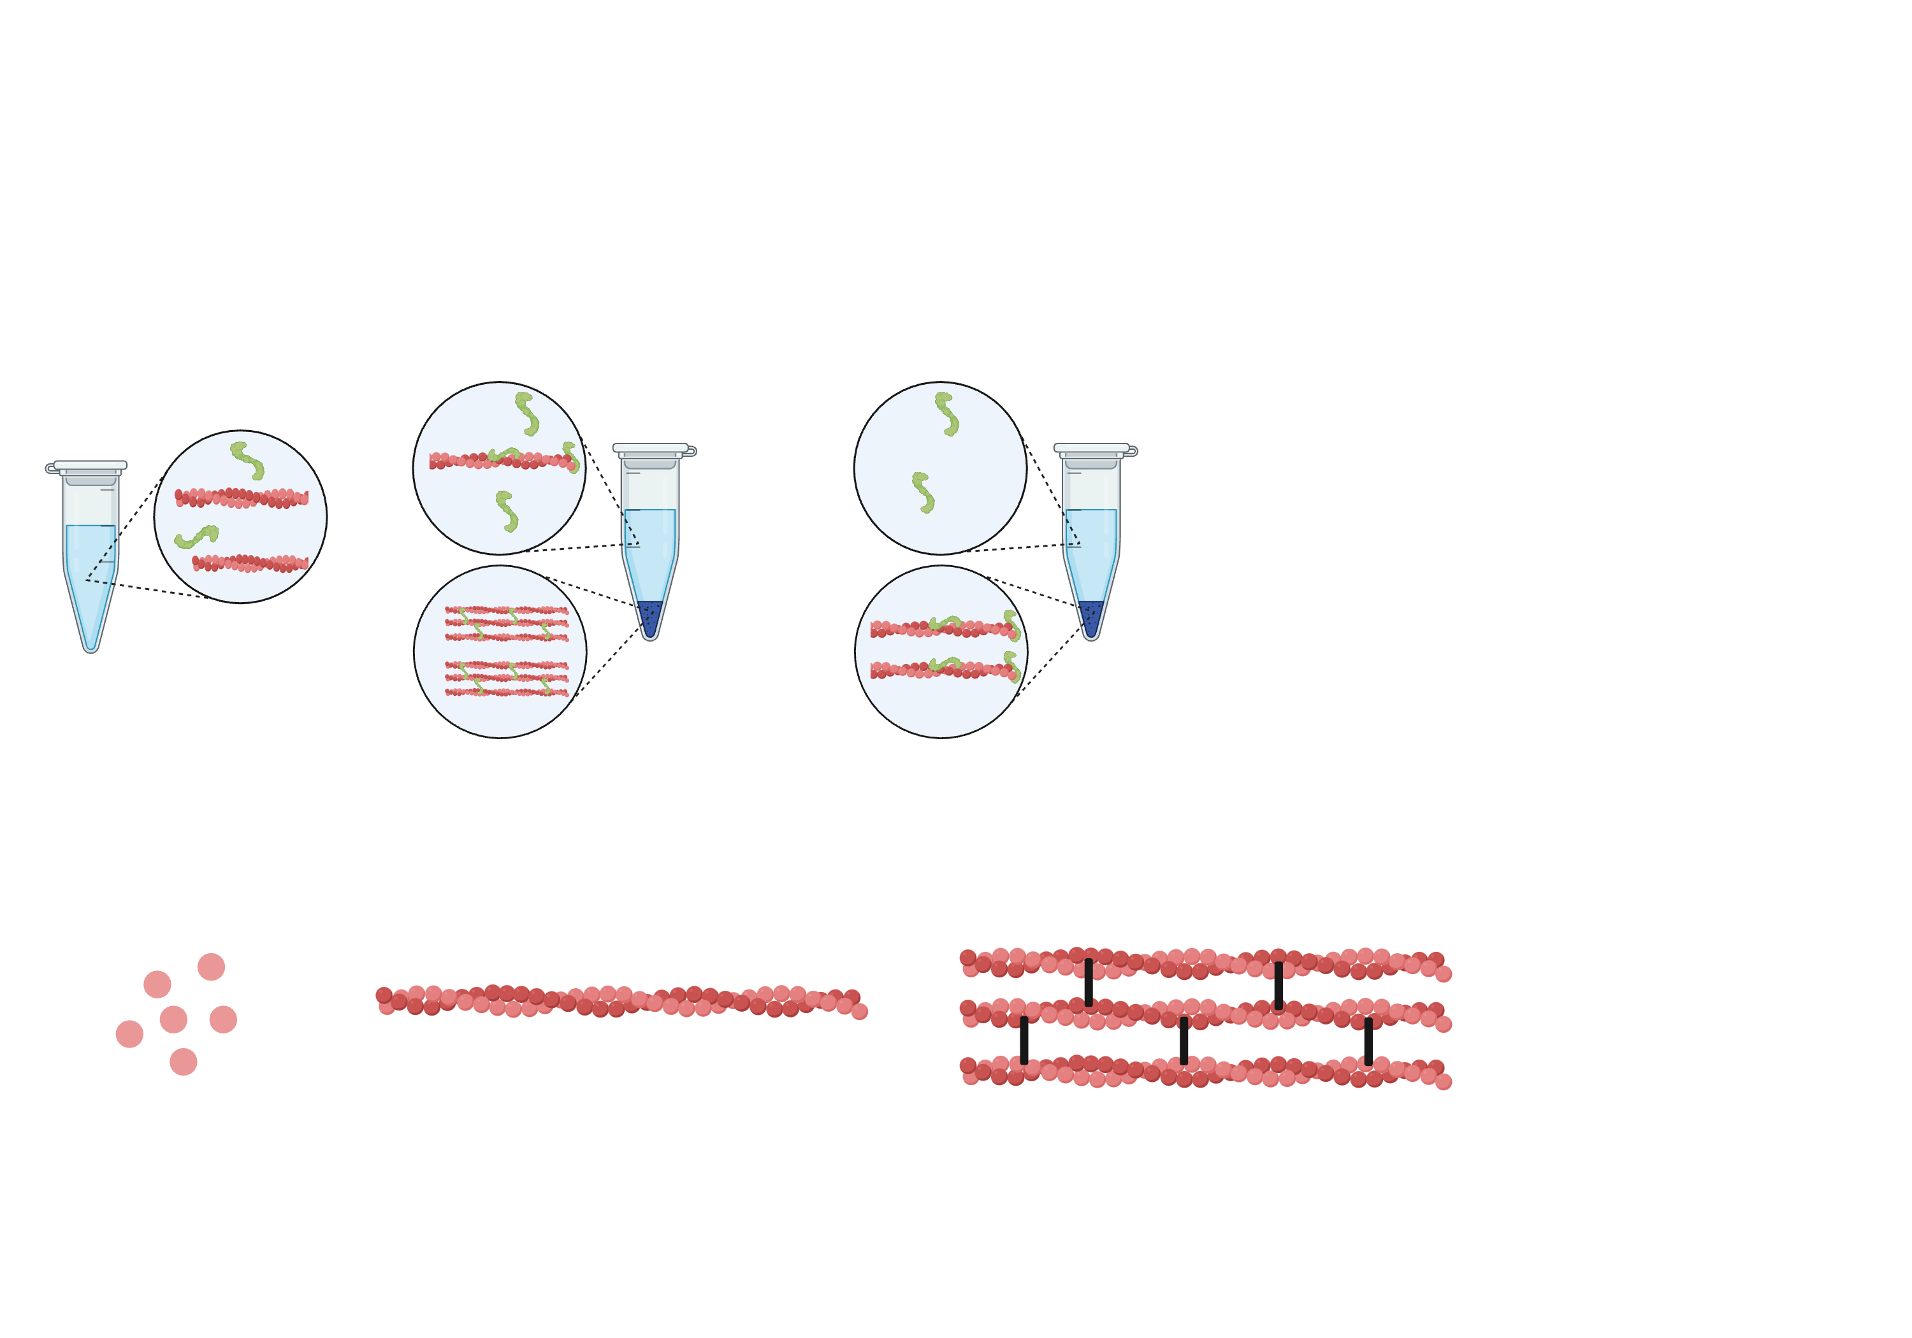
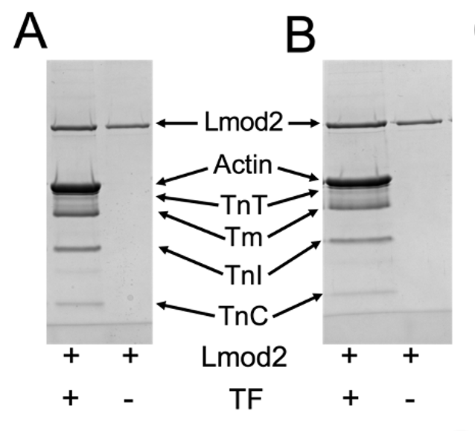
Data Description
Amino Acids 1-384
Amino Acids 1-524
Full-length Lmod2 and fragments produced recombinantly from bacteria were mixed with thin filaments purified from heart muscle at low (pCa>8) and high (pCa 3.5) Ca²⁺ levels
Samples were centrifuged at 213,600 x g so that TFs pellet with bound Lmod2, but free Lmod2 stays in the supernatant
Run on SDS-PAGE gel to separate and identify the amounts of each protein by band densitometry
Subtract the amount of Lmod2 pelleted by itself and divide this by the amount of actin (Lmod2 binds actin subunits of TFs)
Significant Lmod2 bound to TFs in this assay indicates that lateral TF binding occurs
Centrifuge at 213,000 x g
Lmod2
Thin Filaments
Run Pellet on SDS-PAGE Gel

Slide 4
Goal of the Statistical Analysis
The statistical analysis was used to answer three questions in the paper:
Is the C-terminal portion of Lmod2 required to bind the sides of TFs?
Does the WH2 domain play a significant role in lateral TF binding?
Does the amount of Ca²⁺ modulate Lmod2’s lateral TF binding ability?
We wanted to check that the ANOVA was performed properly, and that the data is normally distributed since the sample sizes are low (7-16 repeats per set of effects tested), meaning CLT does not apply.

Slide 5
Statistical Methods
Two ways to ensure the data for each set of effects is normally distributed
Visual: Q-Q plot of sample vs. theoretical quantiles
Statistical Test: Shapiro-Wilk test for normality
Analysis of Variance (ANOVA) with replication + Tukey’s method for multiple comparisons
How does removing C-terminal regions affect the amount of Lmod2 laterally bound to TFs?
How does pCa affect the amount of Lmod2 laterally bound to TFs, and is this effect observed for every fragment tested?

Slide 6
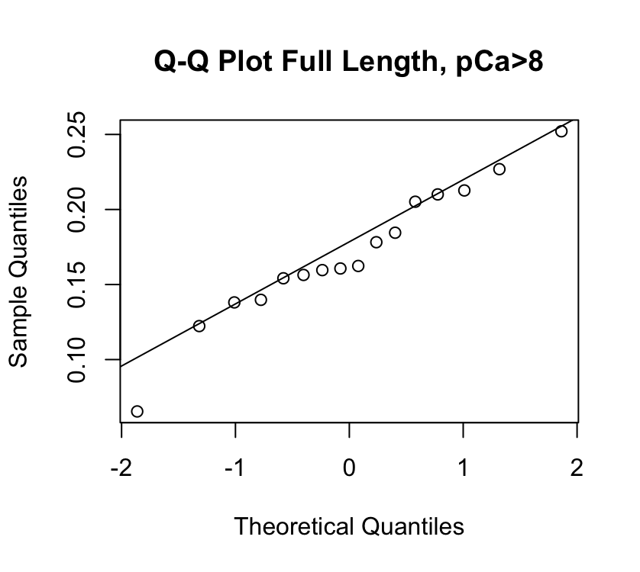
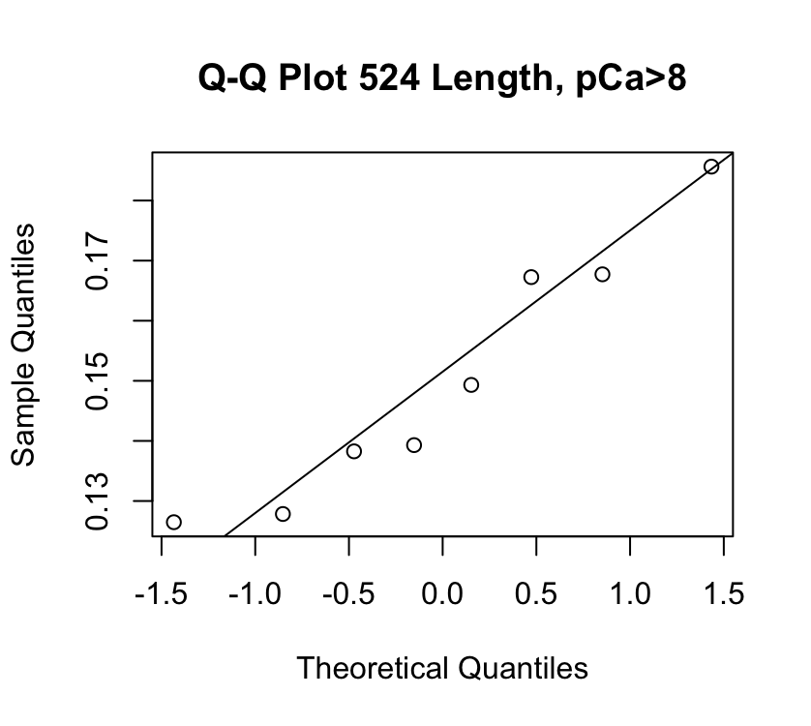
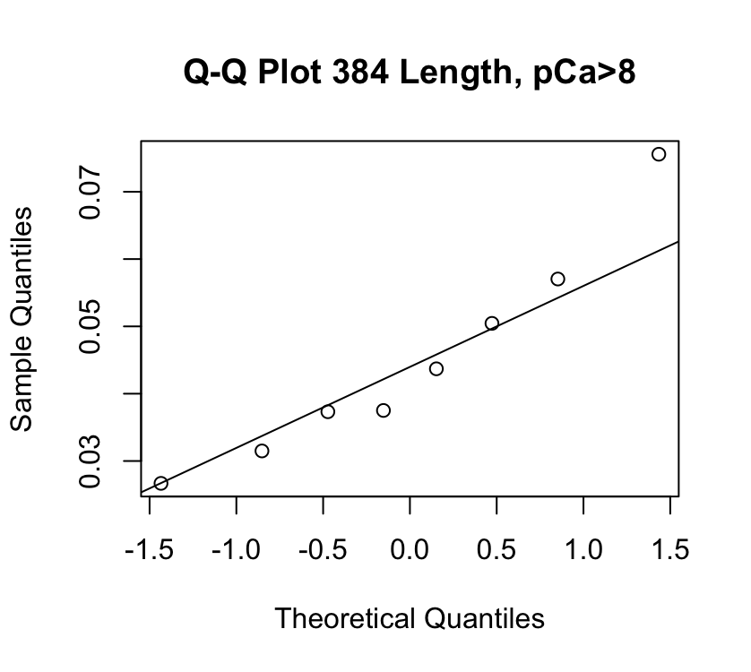
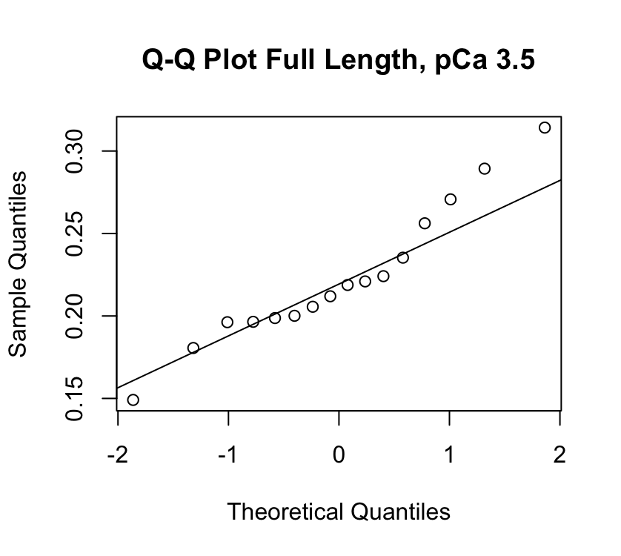
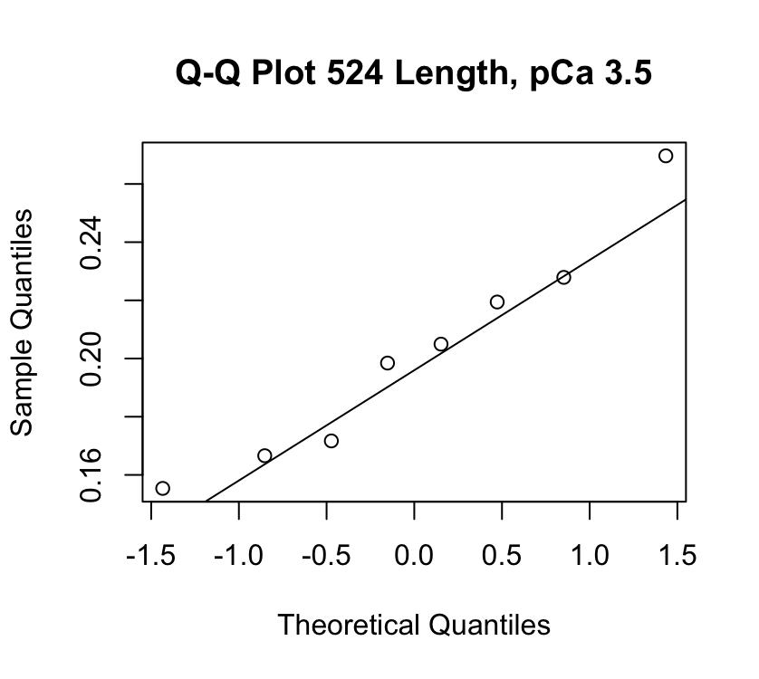
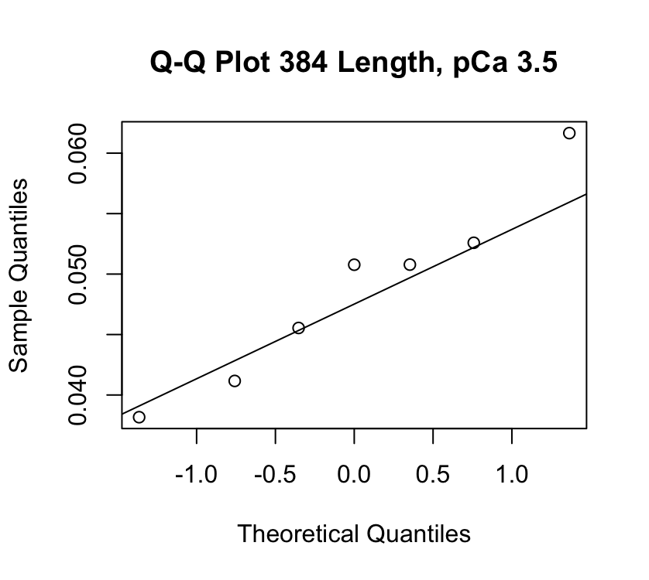
Results - Normality
Shapiro-Wilk
Group | P-value
Full-length, pCa>8 | 0.8169
Full-length, pCa 3.5 | 0.4421
1-524, pCa>8 | 0.4237
1-524, pCa 3.5 | 0.7491
1-384, pCa>8 | 0.5317
1-384, pCa 3.5 | 0.826
Null hypothesis: Data are normally distributed.
Notes:
The q-q plots are pictured here. In addition, the Shapiro-Wilks test failed to reject the null hypothesis that the data is normal for all datasets.

Slide 7
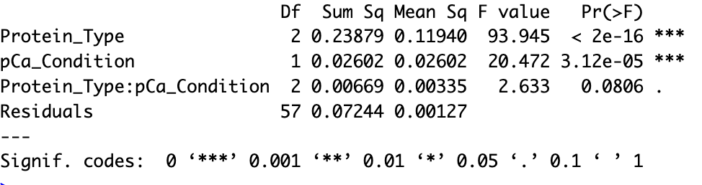
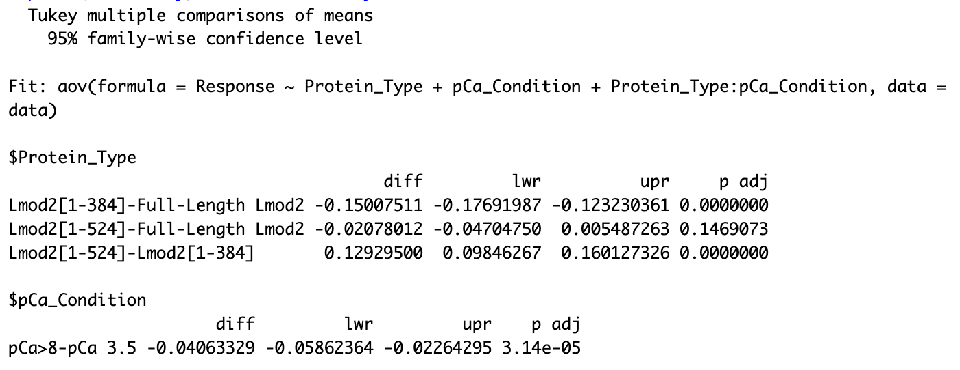
Results – Full ANOVA
Significant effect of protein length and pCa on the amount of Lmod2 laterally bound to TFs (at least one mean is significantly different from the others).
The interaction between length and pCa does not significantly affect the amount of Lmod2 laterally bound to TFs.

Slide 8
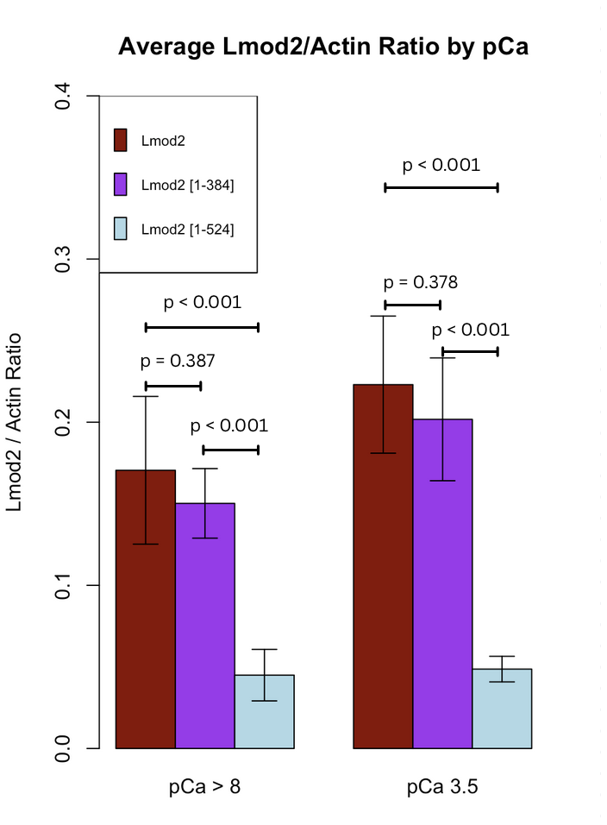
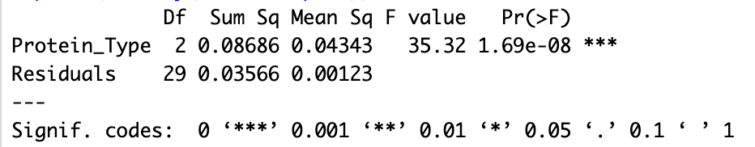


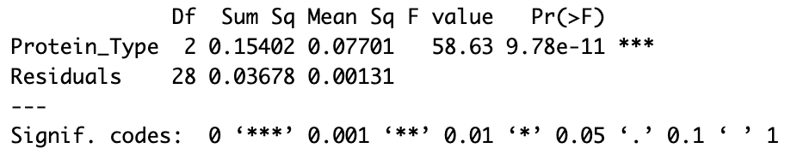
Results - ANOVA Binned by pCa
pCa>8
pCa 3.5
Significant difference in the mean amount of Lmod2 laterally bound to TFs for 1-384 and both full-length/1-524, but not for full-length and 1-524 at both pCas at significance level ⍺=0.05.
Graphs show mean ± standard deviation. P-values generated using Tukey’s method.

Slide 9
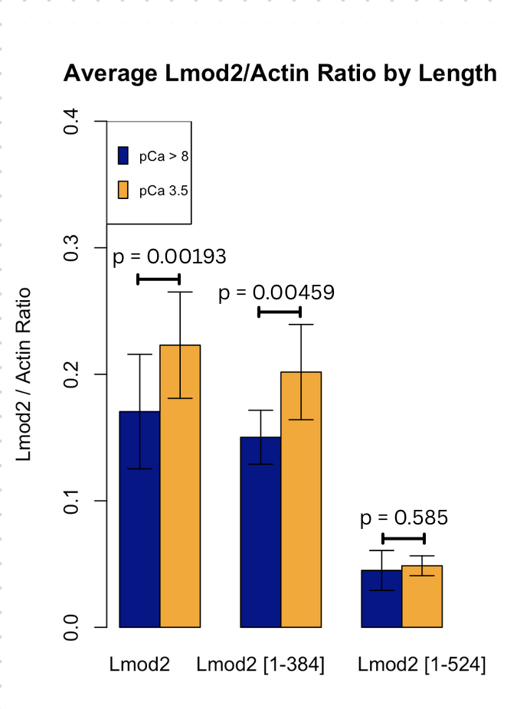
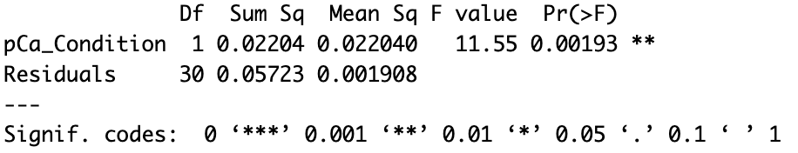
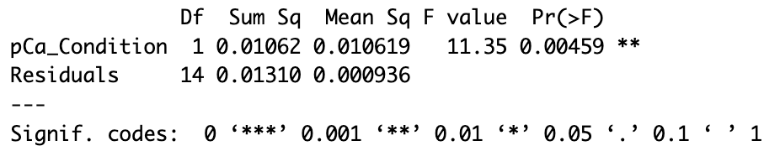
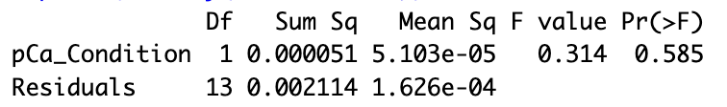


ANOVA – Binned by Length
Full-Length
1-524
1-384
Significant difference in the mean amount of Lmod2 laterally bound to TFs for pCa>8 and pCa 3.5 for full length and 1-524, but not for 1-384 at significance level ⍺=0.05.
Graphs show mean ± standard deviation.

Slide 10
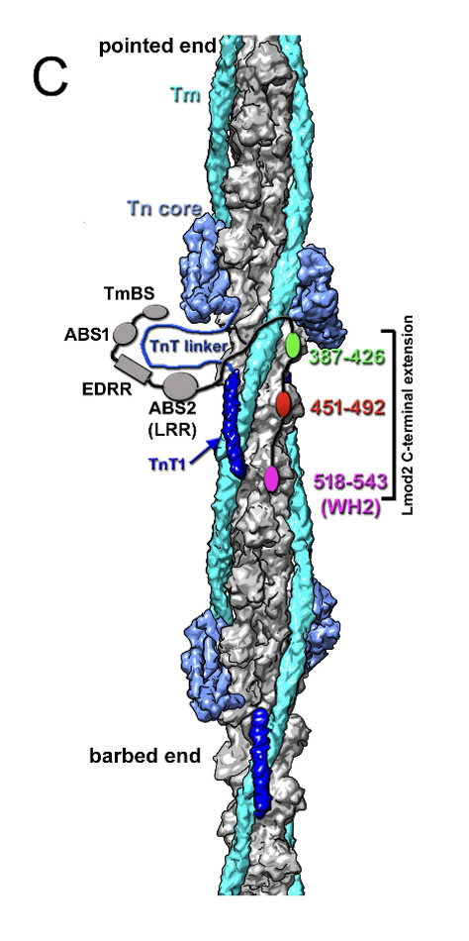
Conclusions
Data are normally distributed, and the statistical tests used are valid
The C-terminus of Lmod2 is required for it to bind laterally to TFs
The WH2 domain does not significantly contribute to the overall interaction.
Ca²⁺ modulates this interaction, which is not observed when the entire C-terminus is removed.
Although our conclusions are identical to the paper, some p-values obtained differed.

